Slide 1
Cloud Manufacturing Platform
Cloud Manufacturing for a Service-oriented Paradigm Shift
Presenter
Rakshit Siddalingappa
Matriculation Number - 11012530
Group 16

Slide 2
About the Paper:
Authors:
Yuqian Lu & Xun Xu
University of Auckland, New Zealand.
Paper presented in IEEE International Conference on Industrial Engineering and Engineering Management at Bandar Sunway, Malaysia.
Published by: IEEE International Conference on Cloud Engineering in the Year 2015. It has 6 Citations.

Slide 3
Agenda:
Aim & Research.
A brief intro in to Cloud Computing.
How & Why Cloud Manufacturing Platform.
Service Science.
Examples.
Cloud Manufacturing Systems.
Architecture, Model, Classification, Control Structure.
Final Words.

Slide 4
Aim & Research Approach
Aim :
Cloud based manufacturing service-oriented business to the customers along with IaaS, PaaS, SaaS.
Research Approach:
How a cloud manufacturing systems will be able to facilitate effective service-oriented business with a framework in the market.

Slide 5
Introduction on Cloud Computing Services
IaaS > Infrastructure-as-a-Service
PaaS > Platform-as-a-Service
SaaS > Software-as-a-Service

Slide 6
How Cloud Manufacturing Platform
Manufacturing businesses are being transformed from product production & physical system-oriented to service-oriented.
The key concept here is to carry out the business transactions on manufacturing services that are typically composed of distributed manufacturing resources owned by service providers.

Slide 7
Cloud Manufacturing Defined:
A model for enabling ubiquitous, convenient, on-demand network access to a shared pool of configurable manufacturing resources (e.g., manufacturing software, equipment & capabilities, as service entities) that can be rapidly provisioned and released with minimal management effort or service provider interaction.
CMFG provides services for a product in Designing, Simulation, Testing, Maintenance.

Slide 8
Comparison of Product Vs. Service Oriented
Which type of product generates more revenue ?
Example – Car & Smart Phone
100%
Hardware-based ( Tangible / Physical System / Product )
Easy to be copied, hard to protect
Less flexible
Revenue Source
Software-based
(intangible services, analysis,
monitoring etc..)
Hard to copy
Agile & Rapid responsiveness
Time

Slide 9
What is Service Science in CMP:
SSME - Service Science, Management & Engineering.
- Study, Design, Implementation.
S
S
SSME
M
E

Slide 10
Pay-as-you-go/use
Manufacturing as a Service (MaaS) frees users from
Heavy investments in expensive hardware (acquisition and upgrading).
Software licensing fees.
Installation
Software updates & upgrades.

Slide 11
Examples:
Autodesk 360 Platform
PLM 360 for Product Lifecycle Management.
Sim 360 for design simulation.
Fusion 360 for 3D direct modelling.
CAM 360 (Industry’s first cloud-based solution for computer aided manufacturing).
Other cloud services includes rendering, design optimization, energy analysis & structural analysis.

Slide 12
Service Oriented Architecture:
SOA provides architecture for the delivery of Web Services.
Independent from Vendors, Products & Technologies.
Service Register
Service Description
Service Discovery
Service Provider
Service Requester
Service Invocation

Slide 13
Manufacturing Industry Perspective
Service Users
Financial flexibility – shifting from capital expenses to operational expenses.
Business agility – pay as you go / good business adaptability.
Instant access to innovation – access to the most advanced resources.
2. Service Providers
Access to a large pool of customers – share manufacturing resources with more customers.
Improving productivity – better utilisation of manufacturing resources.
Business management agility – real-time visibility to market changes.

Slide 14
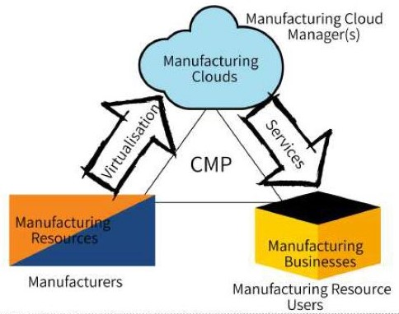
Model of Cloud Manufacturing Platform

Slide 15
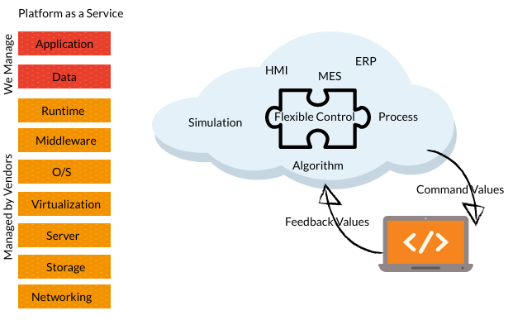
Cloud-based Control-structure
Combining public & private cloud structures to manage & execute the CICS

Slide 16
Technical Challenges
Firstly, a description framework for manufacturing services is needed. Wherein it should be extendable, customisable, quality constraints, processed in different environment like JRE, CLR & DOM.
Secondly, Description of manufacturing resources which includes technical properties & functional capabilities, availability of resources.
Thirdly, Intelligent mapping between service requests & anticipated resources.

Slide 17
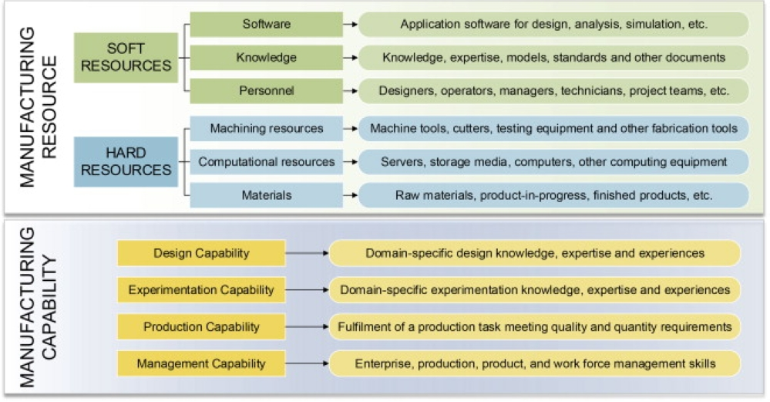
Manufacturing Resources Classification

Slide 18
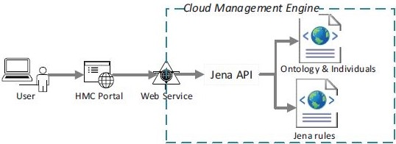
Architecture of the access control module
Access rules from service providers.
Establishing identity of a customer, operations & policies.

Slide 19
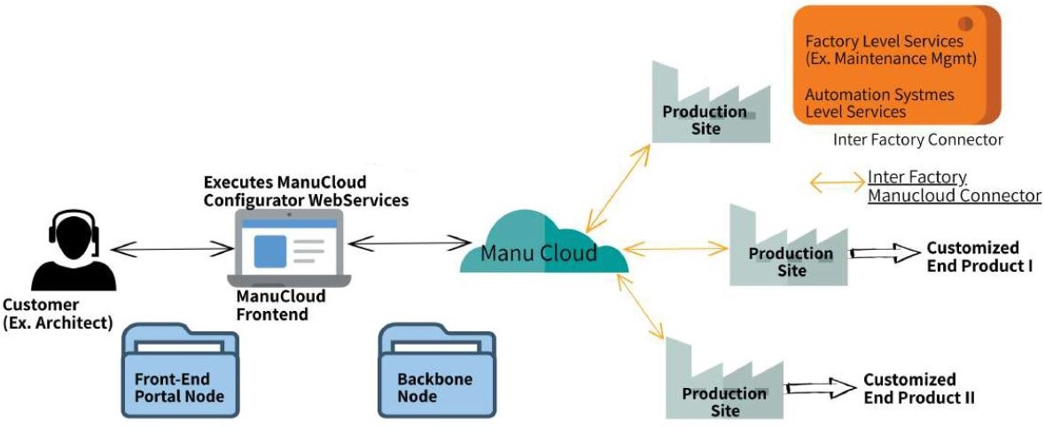
ManuCloud – MaaS (Manufacturing with the Service)

Slide 20
Prerequisites :
Data from all different resources which includes hardware also, Cloud-ready & Cyber Physical Systems.
Data connectivity – Internet of Industrial Things (IoIT).
Data processing & Data analytics.
In-house resources vs. cloud resources.
Resources for private, community and public clouds.

Slide 21
Final Words & Discussion
Cloud computing changes the way manufacturing enterprises do businesses.
Industry perspective – the real needs of industry.
Key to success of cloud manufacturing are Data connectivity, Data process, Analytics, Smart factories, Cyber-physical systems.
Companies to collectively take on more substantial and complex projects.
Resources-sharing like manufacturing software tools, equipment and fabrication capabilities with other companies.
Good fit for countries with many SMEs to take on big projects.

Slide 22
References
Xun Xu, "From cloud computing to cloud manufacturing," Robotics and Computer-Integrated Manufacturing, vol. 28, pp. 75-86, Feb 2012.
http://www.teslamotors.com/, Accessed on: 11 Jun, 2014.
https://360.autodesk.com/, Accessed on: 11 Jun, 2014.
Y. Lu, J. Xu, and X. Xu, "A New Paradigm Shift for Manufacturing Businesses," in IMECE2013, San Diego, California, 2013, Paper IMECE2013-62640

Slide 23
THANK YOU
Any Questions ?

